Slide 1
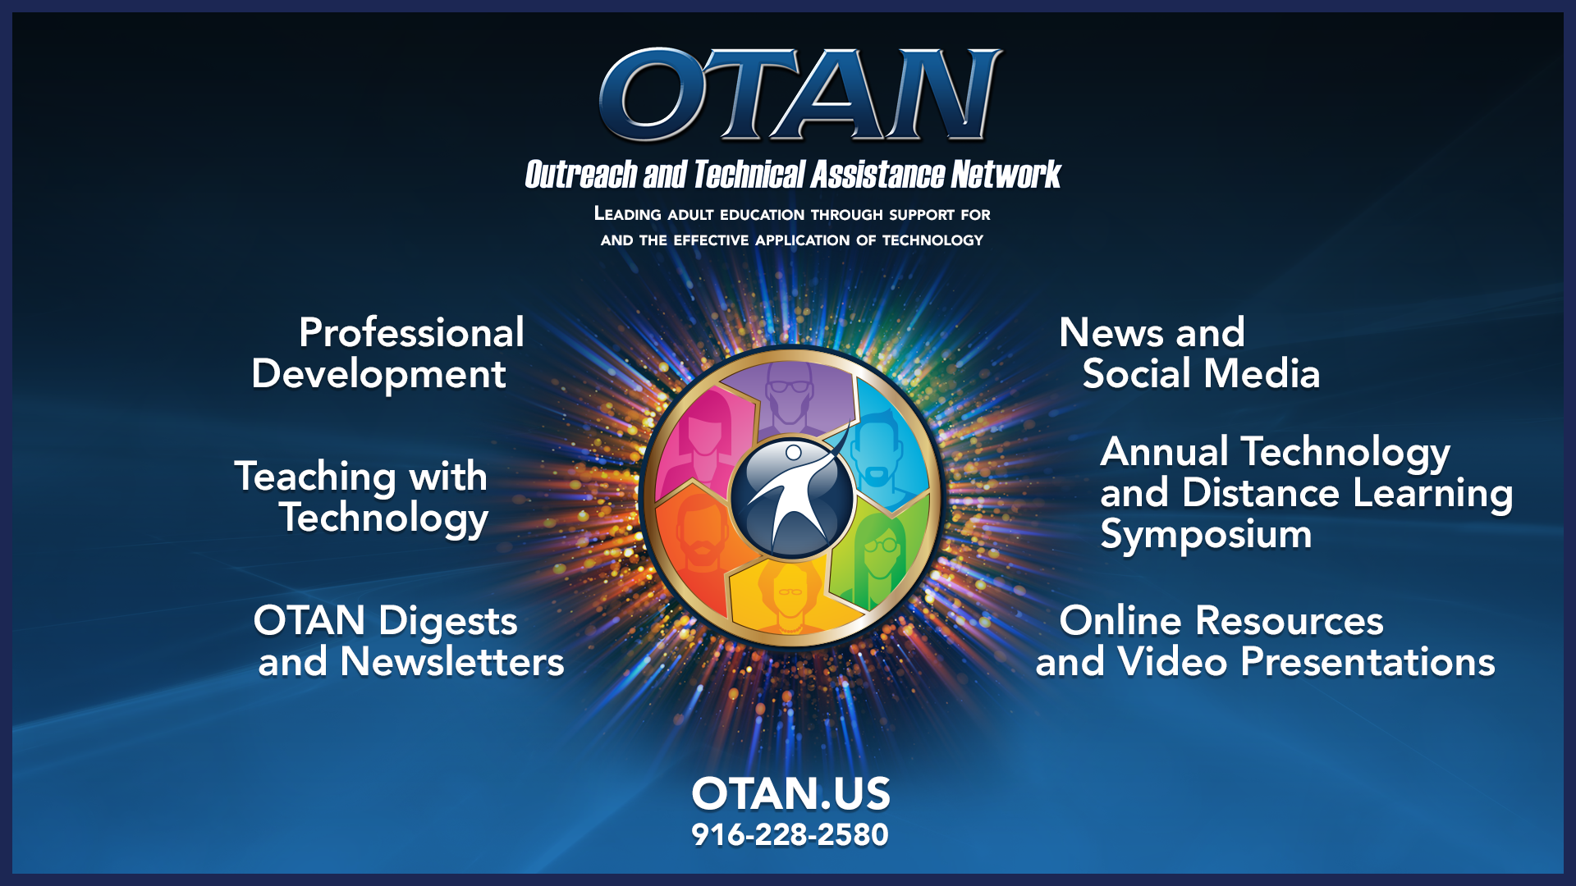
OTAN Resources

Slide 2
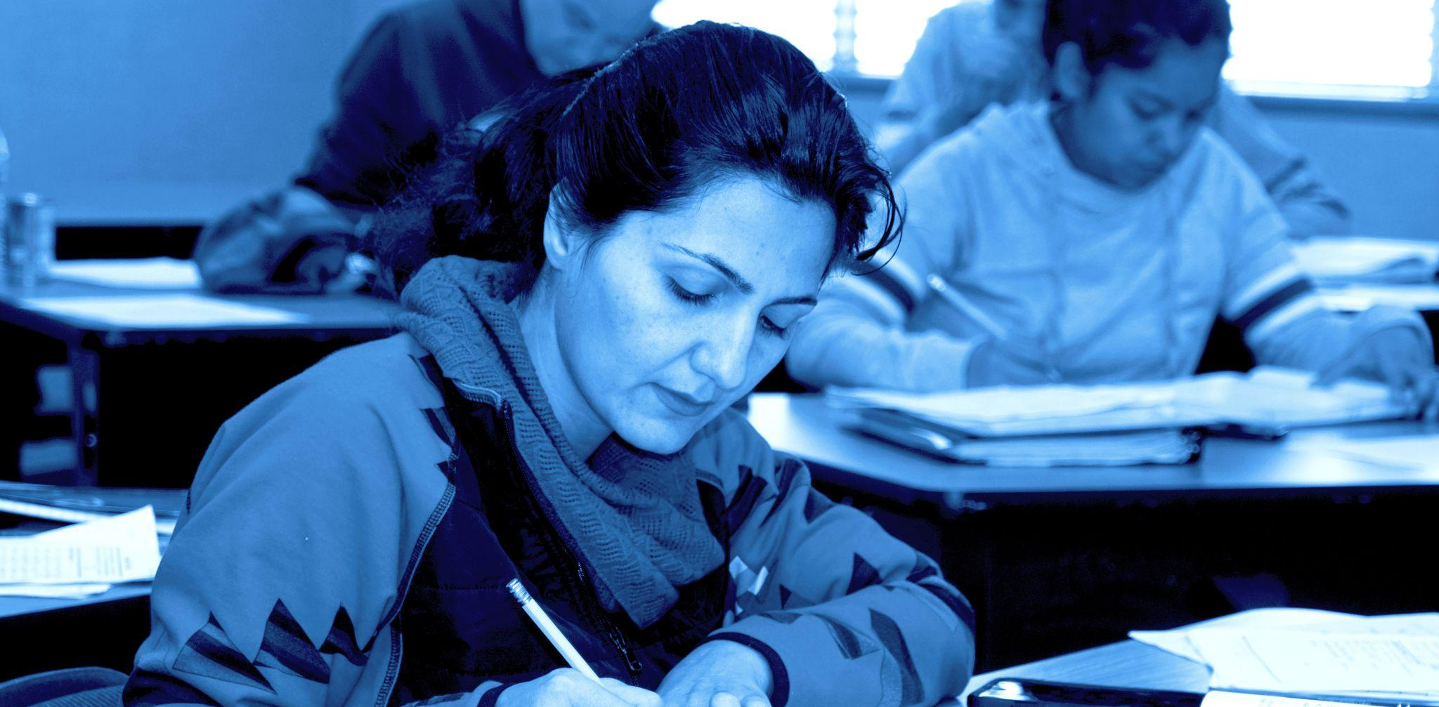
Welcome to Chapter 2!
Ensuring Equity and Access

Slide 3
Session Objectives
Understand and explain the principles of the Web Content Accessibility Guidelines (WCAG) and Universal Design for Learning (UDL)
Apply WCAG and UDL principles in the design of digital learning materials
Use specific digital tools effectively to enhance accessibility and inclusivity in digital learning materials
Notes:
🕧 = 1 minute
Welcome the group to the session on the principles of Web Content Accessibility Guidelines (WCAG) and Universal Design for Learning (UDL) and their significance in creating inclusive digital learning environments.
📄Reference to DLG*. Today’s session and activity are focused on Chapter 2 of the Digital Learning Guidance, which is published as a PDF on the OTAN site alongside a self-paced course in Canvas where you can explore these ideas in more depth.
Introduce today’s focus = exploring WCAG and UDL frameworks and how they can help us in designing accessible and inclusive learning experiences
Review today’s objectives:
Understand and explain the principles of the Web Content Accessibility Guidelines (WCAG) and Universal Design for Learning (UDL)
Apply WCAG and UDL principles in the design of digital learning materials
Use specific digital tools effectively to enhance accessibility and inclusivity in digital learning materials
By the end of this session, we will have a solid foundation in WCAG and UDL, practical skills to apply these principles in your instructional design, and knowledge of digital tools that can further enhance accessibility and inclusivity in digital learning materials.
Links:
DLG Chapter 2: https://otan.us/media/tysjmzko/ca_adult-learning-guide_081822-a11y.pdf#page=30

Slide 4
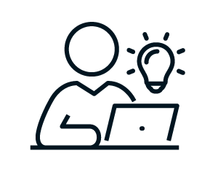


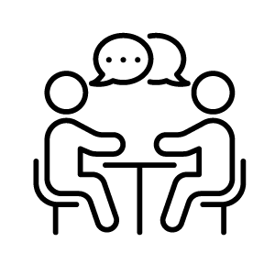
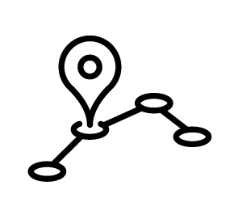
Session Agenda
Reflect on the importance of accessibility and inclusivity
Explore the principles of WCAG and UDL
Revise a sample lesson plan or program resource for accessibility
Discuss the application of WCAG and UDL in practice
Explore next steps
Notes:
🕧 = 1 minute
Today’s agenda includes opportunities to explore accessibility ideas, to brainstorm with peers/colleagues, and to spend time applying key principles of adult learning into our classrooms and programs.
We will begin by reflecting on the significance of accessibility and inclusivity in the context of digital learning. We'll explore why it is crucial to design learning experiences that cater to the diverse needs and abilities of our learners.
Next, we will dive into the principles of WCAG and UDL. We'll gain a deeper understanding of each framework, exploring how they provide guidance and best practices for creating accessible and inclusive learning materials and environments.
We’ll also practice using specific digital tools that can enhance accessibility in our learning materials. We'll explore how these tools can support different aspects of accessibility and provide practical examples of their usage.
With those tools, we’ll revise a sample lesson plan or program resource for accessibility.
Lastly, we’ll engage in a discussion about the application of WCAG and UDL in real-world scenarios.

Slide 5
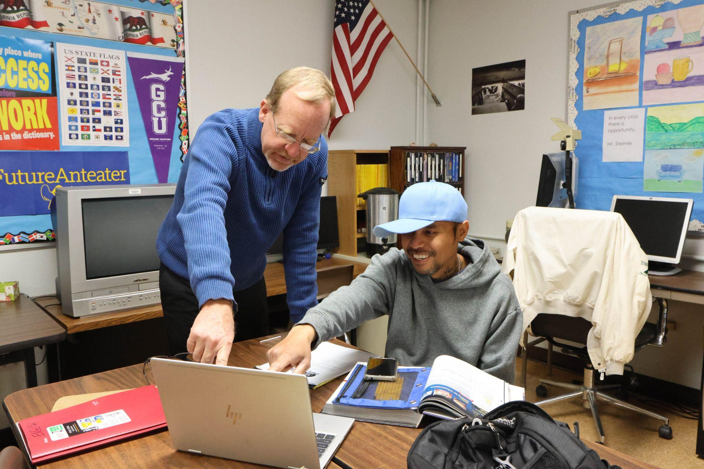
Quick Brainstorm
Think-Pair-Share
What’s a digital tool that your students have found easy to use?
What’s a digital tool that your students have found hard to use?
Notes:
🕧 = 10 minutes
🗣️ Facilitation tip. The purpose of this warm-up activity is to foster a collaborative and supportive environment, encouraging open dialogue and knowledge-sharing. There is no “right” or “wrong” answer, which is important to emphasize.
We'll start with a warm-up activity focused on digital tools. We want to tap into your experiences as educators and gather insights on the tools your students have found both easy and challenging to use. This discussion will help us explore the role of digital tools in creating inclusive and accessible learning environments.
💻 Digital tools connection. Be sure to set-up the Mentimeter Q&A session*. before the session and add the link/code to the speaker notes and to the slide for easy reference*. (🚩Note that you’ll need to create an account to use this feature).
Navigate to Mentimeter on your device or smartphone. You can access it by visiting [provide Mentimeter website or URL].
Once you're on the Mentimeter homepage, enter the code [provide the unique code for the activity] to join our session.
You'll see two questions on the screen:
What's a digital tool that your students have found easy to use?
What's a digital tool that your students have found hard to use?
Take a moment to reflect on your own teaching experiences and consider specific examples of digital tools that have elicited positive or negative feedback from your students.
Share your responses by typing them into the Mentimeter platform.
As you submit your responses, they will appear on the screen in real-time, allowing everyone to see and engage with the ideas being shared.
🗣️ Facilitation tip. After everyone has had a chance to response, spend a few minutes highlighting interesting responses. Be careful not to suggest any response as correct or incorrect. Instead, just highlight anything that is thought-provoking. As you read responses, say things like:
“Oh that’s interesting.”
“Has anyone experienced something similar.”
“That’s insightful.
🗣️ Facilitation tip. Consider also drawing the connection between these brainstorming questions and the concepts to be explored later in the session re: WCG and UDL:
“UDL principles include engagement and representation. By exploring which tools provide intuitive and accessible interfaces for learners, we can promote greater learner autonomy.”
“WCAG and UDL guidelines encourage reflection on potential barriers to operability and accessibility in digital tools, offering opportunities to identify areas for improvement in providing equal access to all students.”
Links:
Mentimeter Q&A Session: https://www.mentimeter.com/features/live-questions-and-answers
How to run a Mentimeter Q&A Session: https://help.mentimeter.com/en/articles/1501502-questions-from-audience

Slide 6
Introducing WCAG
WCAG is based on four principles that content should be:
Perceivable
  e.g., Using alt-text with images
Operable
  e.g., Compatible with keyboard accessibility
Understandable
  e.g., Clear and straightforward language
Robust
  e.g., Compatible with screen readers and other tools
Notes:
🕧 = 2 minutes
Introduce each of the WCAG principles, providing a brief explanation with examples of each concept:
Perceivable: Making digital content accessible and understandable to all users through various sensory modalities such as sight, hearing, and touch.
Why it’s important: Ensures that digital content is presented in a way that can be perceived and understood by all users, including those with visual or hearing impairments.
Examples of perceivable design: Including alt-text for all images. Alt-text can be read by screen readers
Operable: Designing digital content in a way that allows users to interact with and navigate through it using a keyboard or other input methods.
Why it’s important: Crucial for individuals who may have mobility impairments or rely on assistive technologies such as screen readers and only use keyboards without a mouse.
Examples of operable design: Integration of keyboard shortcuts that provide an efficient way for users to navigate within content without needing to rely on sequential tabbing.
Understandable: Ensuring that digital content and user interface are clear, logical, and easy to comprehend for all users, including those with cognitive or language barriers.
Why it’s important: Enables users to navigate, comprehend, and interact with digital content effectively.
Examples of operable design: Using plain language, avoiding jargon or complex terminology, and providing clear instructions
Robust. How readily digital content can be reliably interpreted and utilized by a wide range of users, including those using different devices, browsers, and assistive technologies.
Why it’s important: Ensures that digital content remains accessible and usable across various platforms, technologies, and user preferences. By designing robust content, educators can reach a broader audience and accommodate diverse learning needs.
Examples of robust design: Using HTML for web content instead of proprietary formats ensures compatibility with different browsers and assistive technologies. Providing alternative text descriptions for images enhances the interpretability of content by screen readers.

Slide 7
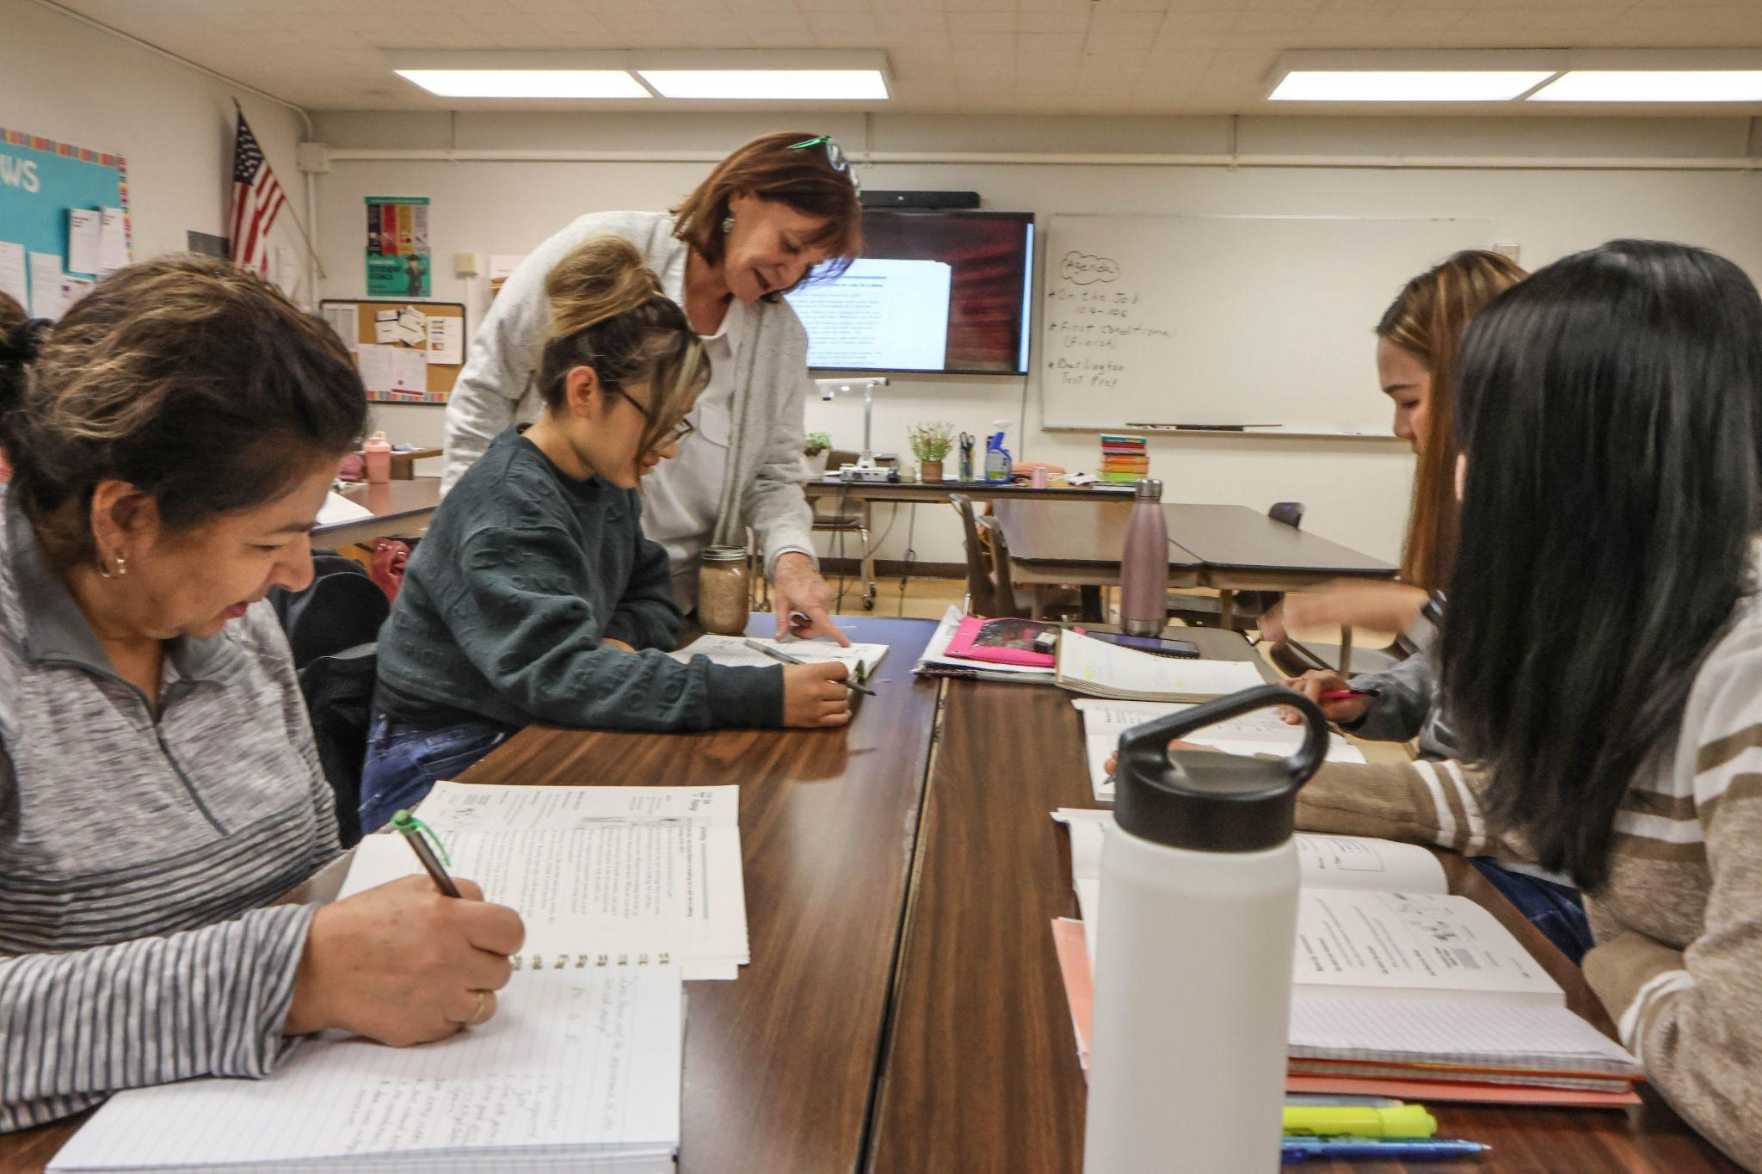
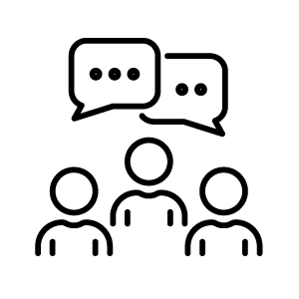


Introducing UDL
UDL explores content accessibility through providing multiple means of:
Engagement
Representation
Action and Expression
Notes:
🕧 = 2 minutes
Introduce each UDL concept:
Engagement: Providing learners with diverse options and opportunities to be motivated, interested, and invested in the learning process by offering choices, personalization, and meaningful connections.
Why it’s important: Acknowledges that learners have different interests, preferences, and motivational factors that can influence their engagement in the learning experience.
Examples of providing multiple means of engagement: Provide options for learners to choose topics or activities that align with their interests, offer opportunities for collaboration and interaction with peers, integrate real-world connections and authentic tasks, incorporate multimedia elements such as videos, audio, or visuals to enhance engagement, and allow learners to make decisions and have control over their learning journey.
Representation: Presenting information and content in various formats, modalities, and styles to accommodate different learning styles, preferences, and abilities.
Why it’s important: Recognizes that learners perceive information in different ways, and by providing multiple means of representation, educators can enhance comprehension, accessibility, and inclusivity.
Examples of providing multiple means of representation: Using visual aids such as images, diagrams, and infographics to supplement textual information, providing captions and transcripts for audio and video content, offering alternative formats such as braille or large print for learners with visual impairments, using interactive simulations or manipulatives to facilitate experiential learning, and employing assistive technologies like screen readers or text-to-speech tools to support learners with reading difficulties.
Action and Expression: Providing learners with various options and opportunities to actively engage, interact, and demonstrate their understanding and knowledge.
Why it’s important: Empowers learners to showcase their learning in ways that are meaningful and accessible to them, fostering their creativity, critical thinking, and communication skills.
Examples of providing multiple means of action and expression: Allowing learners to choose from different modes of response such as written assignments, oral presentations, visual projects, or multimedia creations, providing options for collaborative activities, discussions, or individual reflections, offering alternative assessment formats to accommodate diverse abilities and preferences, and leveraging technology tools and platforms that support diverse modes of communication and content creation.

Slide 8
Revising a Program Resource with UDL Part I
Revising program materials
Choose a program resource to revise
  Program website, lesson plan, outreach materials
Review the content and identify areas where learners may have difficulty understanding the information
Revise the resource to include multiple means of representation
  Visual aids, captions or transcripts for audio, or alternative text for images
Share with a neighbor for feedback
Notes:
🕧 = 15 minutes
This is the first of a two-part activity.
The first task is to apply the principles of Universal Design for Learning (UDL) to ensure that content is accessible and engaging for all learners. This activity will set the foundation for the subsequent task and help create a more inclusive learning experience.
Introduce the activity as "Multiple Means of Representation" and explain that participants will be working with a program resource of their choice.
e.g., Program website, content in a lesson plan, outreach materials
Instruct participants to review the content and identify areas where learners may face challenges in understanding or accessing the information.
Encourage participants to consider providing multiple means of representation to address diverse learner needs
Examples include adding visual aids, captions or transcripts for audio content, or alternative text for images.
Instruct participants to share their revised resource with a colleague and engage in a discussion about the impact of the modifications on accessibility and engagement.
💻 Digital Connection. The following tools could be helpful for applying UDL principles:
Sutori (https://www.sutori.com/en/): Sutori is an interactive storytelling and presentation tool that allows educators to create visually engaging content with multimedia elements. It can be used to provide multiple means of representation by incorporating images, videos, and interactive elements into program resources.
Canva (https://www.canva.com/): Canva is a graphic design platform that offers a wide range of templates and design elements to create visually appealing materials. Educators can use Canva to create infographics, visual aids, or alternative representations of content to support diverse learners.
Read&Write (https://www.texthelp.com/products/read-and-write-education/): Read&Write is a literacy support tool that provides features like text-to-speech, word prediction, and text highlighting. It can support learners with reading difficulties or those who benefit from auditory reinforcement. Educators can use Read&Write to ensure content is accessible and understandable for all learners.
Padlet (https://padlet.com/account/setup): Padlet is a collaborative digital board that allows users to create and share content in various formats, including text, images, videos, and audio recordings. It can be used to provide multiple means of engagement and representation by allowing learners to interact with content through different modalities and collaborate with peers.

Slide 9
Making Language More Accessible
The Plain Language Act
Review a few of the “Before and after” examples on the Plain Language website
In groups, discuss what you notice and wonder about each revision to the language presented
As you review, consider which program resource you’d like to simplify
  e.g., Program website, content in a lesson plan, outreach materials
Notes:
🕧 = 10 minutes
To lay the foundation for the second part of the activity, we’re going to review a useful resource for supporting accessibility.
The Plain Language Act promotes the use of clear and simple language in government communications to enhance understanding and accessibility.
💻 Digital Connection: The Plain Language Act website includes several examples and non-examples of clear and simple language, including “before and after” so people can compare and contrast how applying the Plain Language Act can change a user experience
Share the Plain Language Act website with participants. Ask them to read a few of the before and after examples.
In groups, discuss what you notice and wonder about these language changes.
Think about your own program’s website, outreach materials, and our content used in actual lesson plans.
Links:
The Plain Language Act website: https://www.plainlanguage.gov/examples/before-and-after/

Slide 10
Revising a Program Resource with UDL Part II
Simplifying program materials
Review the resource from the first activity (or choose a new one)
  e.g., Program website, content in a lesson plan, outreach materials
Spend a few minutes identifying complex sentences, jargon, and/or instructions that are not clear
  Consider using the Hemingway Editor
Share with a neighbor to get feedback
Notes:
🕧 = 15 minutes
Now with the Plain Language Act in mind, we will be focusing on simplifying our program materials to enhance accessibility.
To begin, choose a program resource that you would like to revise (either the same as part 1 in today’s session, or a new resource).
Spend a few minutes reviewing it and identifying complex sentences, jargon, or instructions that may not be clear to learners. We want to ensure that our materials are easily understandable and accessible to a wide range of learners.
💻 Digital Tool Connection. Remember to refer to the Plain Language Act website* for ideas, examples, tips, etc.
💻 Digital Tool Connection. Consider/recommend using the Hemingway Editor*, which is a helpful online tool that can assess written language to determine levels of complexity and suggest ways to simplify readability. It can be a valuable resource in identifying which parts of written language could be improved and for making your revisions more effective.
🗣️ Facilitation tip. You can model the use of the Hemingway Editor* using examples from the Plain Language Act website. For example, copy and paste the “Before” language from the Medicaid Eligibility example here* into the Editor. Then, showcase how the color coding can help to identify elements of written text that could be improved. Those can be great starting places for educators to figure out how and where to begin revising complex language.
Next, share your Before and After with a peer. Spend a few minutes explaining which revisions you’ve made. Peers can offer feedback and suggestions to help continue revising and improving the text.
Questions to consider as you review each other’s materials include:
How effectively does the revised resource simplify complex sentences and remove jargon? Discuss specific examples where the language has been clarified and made more accessible to a diverse audience.
In what ways does the revised resource demonstrate improved clarity of instructions? Identify any areas where confusion may still exist and offer suggestions for further enhancements.
Links:
The Plain Language Act website: https://www.plainlanguage.gov/examples/before-and-after/
Hemingway Editor: https://hemingwayapp.com/
Medicaid Eligibility example: https://www.plainlanguage.gov/examples/before-and-after/medicaid-eligibility/

Slide 11
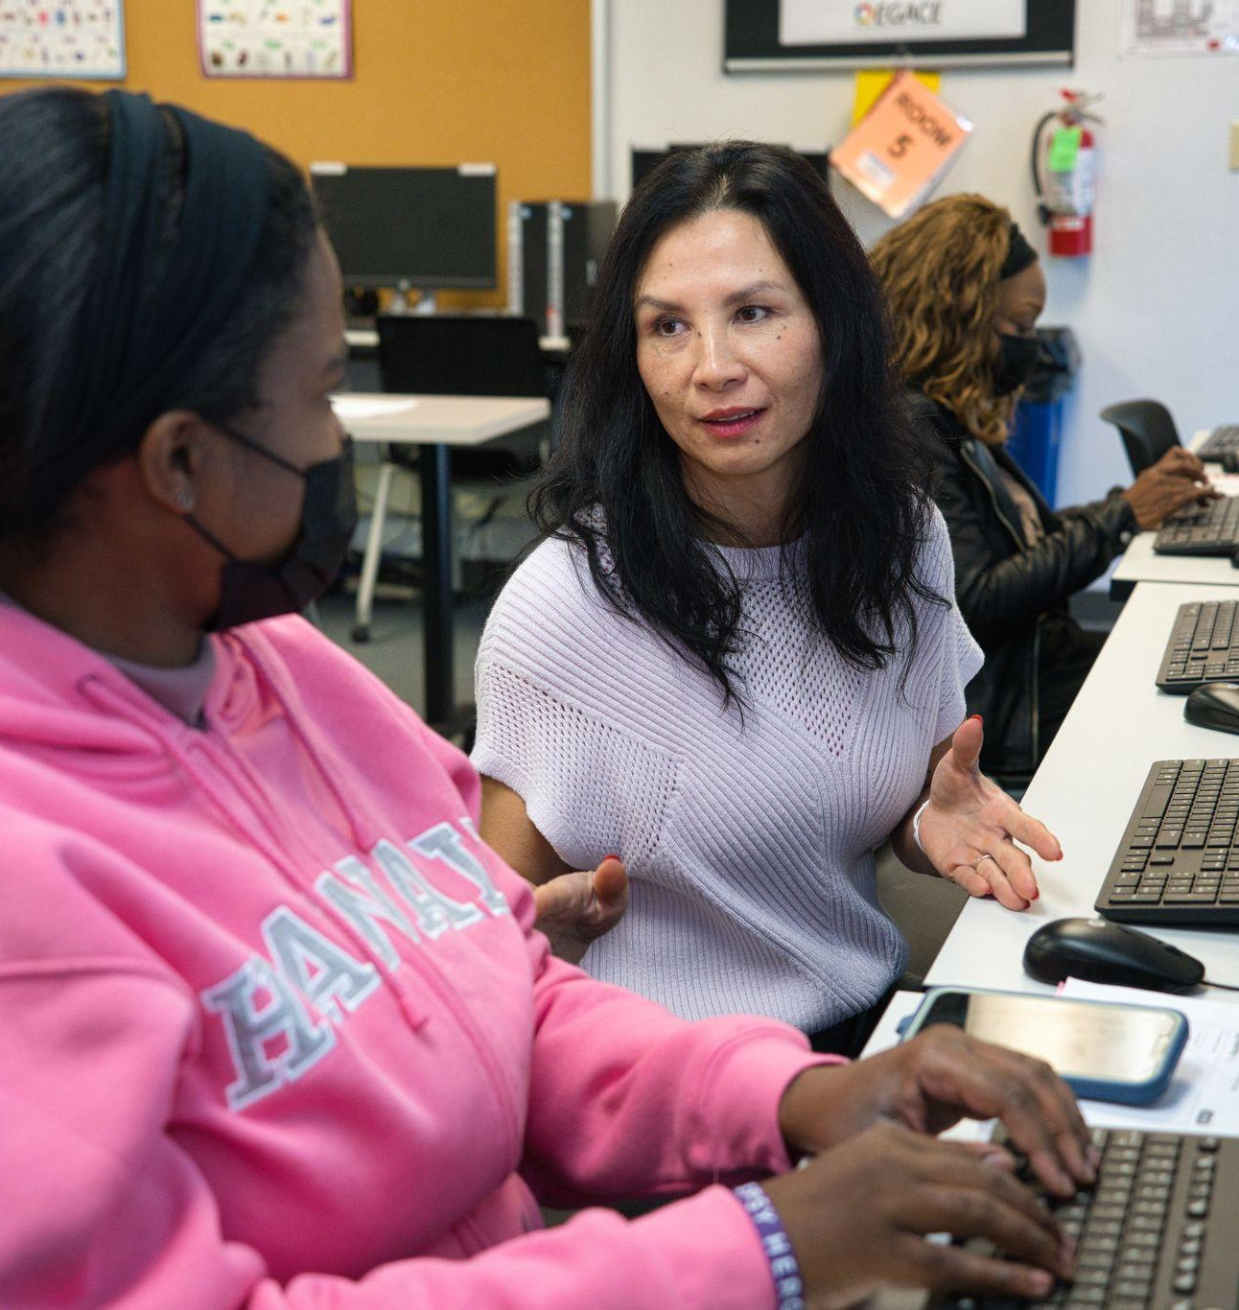
Reflecting about Accessibility
Think-Pair-Share
In what ways can digital tools enhance implementation of UDL and WCAG principles?
What challenges were encountered with applying UDL and WCAG principles to program materials?
  What were the strategies or resources that were helpful for addressing those challenges?
Notes:
🕧 = 10 minutes
In groups, discuss these two questions:
In what ways do you think digital tools can enhance the implementation of WCAG and UDL principles?
Share your thoughts and experiences on using specific tools and their effectiveness in supporting diverse learner needs and abilities.
Reflecting on the revision activity we completed earlier, what challenges did you encounter when applying WCAG and UDL principles to improve the accessibility of the lesson plan or program resource? How did you address those challenges, and what strategies or resources did you find helpful? Share your insights and learnings with the group.
After 5 minutes of discussion, encourage groups to share highlights of the conversation
As each group talks, take note of any specific ideas that you can highlight as an opportunity to help educators continue envisioning ways to support accessibility
The goal here is to inspire the group to want to continue working on accessibility after the session by emphasizing specific ideas that help educators develop a vision of where to go after the session ends

Slide 12
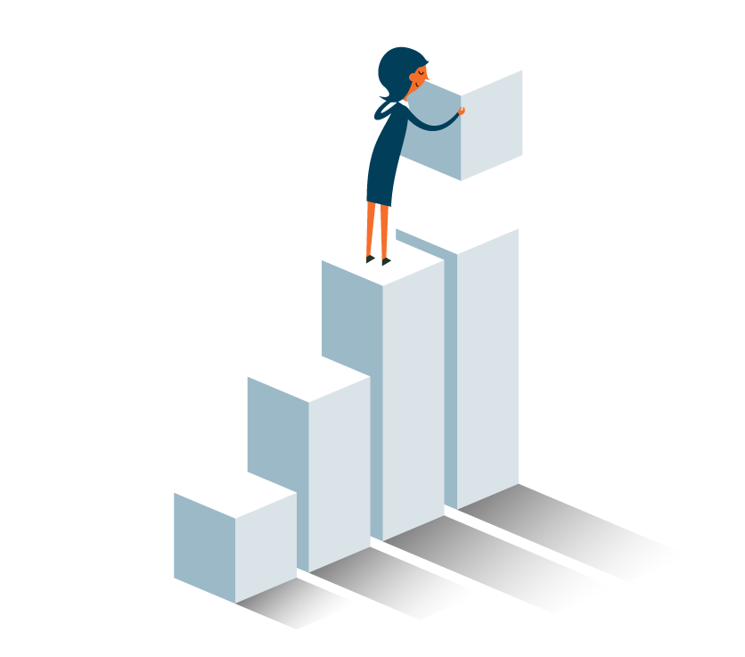
What’s Next?
Chapter 2 of the Digital Learning Guidance provides more details and discussion of key principles
The self-paced course on the OTAN website includes a multiple-choice quiz and extension activities
Continue finding opportunities to simplify program materials to improve readability and accessibility
Notes:
🕧 = 5 minutes
Spend a few minutes reviewing key concepts from the session, including suggestions for continuing to learn about both frameworks:
Today, we explored two important frameworks for creating inclusive and accessible learning experiences: Web Content Accessibility Guidelines (WCAG) and Universal Design for Learning (UDL). Let's recap the key concepts:
WCAG:
WCAG is a set of guidelines that provide standards for making digital content accessible to individuals with disabilities.
Key principles of WCAG include perceivable content (ensuring information can be perceived through multiple senses), operable content (ensuring content can be interacted with using various input methods), understandable content (ensuring content is clear and easy to comprehend), and robust content (ensuring content can be interpreted by a wide range of technologies).
Applying WCAG principles involves techniques such as providing alternative text for images, adding captions to videos, and structuring content using proper headings and labels.
The Plain Language Act promotes the use of clear and simple language in government communications to enhance understanding and accessibility.
💻 Digital Connection: The Plain Language Act website* includes several examples and non-examples of clear and simple language, including “before and after” so people can compare and contrast how applying the PLA can change a user experience
UDL
UDL is a framework that promotes designing learning experiences that address the diverse needs and preferences of all learners.
UDL emphasizes providing multiple means of engagement (varied options for motivation and interest), multiple means of representation (presenting information in diverse formats), and multiple means of action and expression (providing options for learners to demonstrate their knowledge and skills).
By implementing UDL, we create inclusive learning environments that accommodate learner variability and enhance accessibility for learners to become lifelong, self-directed learners.
Suggestions for continued learning
W3C Web Accessibility Initiative (WAI) website*: Provides comprehensive information about WCAG and related accessibility topics, including tutorials, techniques, and resources.
CAST's UDL Guidelines*: Offers detailed guidelines and examples for applying the principles of UDL in educational settings.
Explore OTAN’s self-paced course in Canvas.
Connect with professional communities: Engage with educators and accessibility professionals through online forums, social media groups, and conferences to share ideas and best practices.
Links:
The Plain Language Act website: https://www.plainlanguage.gov/examples/before-and-after/
W3C Web Accessibility Initiative website: https://www.w3.org/WAI/
CAST's UDL Guidelines: https://udlguidelines.cast.org/

